Slide 1

Fifa19
Team Members:
Akshay Nimbalkar
Divyansh Kumar Singh
Harish Fegade

Slide 2
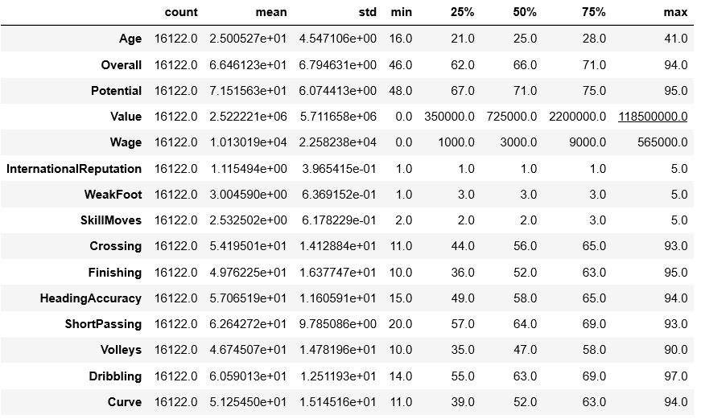
Understanding Data
DataSet dimensions | 18207 x 89
No. of Categorical Variables | 14
No. Numeric Variables | 75
No. of features with missing data | 78

Slide 3
Problem Statement
Problem Statement
Predicting market value of players.

Slide 4
Workflow
Data Cleaning:
Mean Imputation,
Decision Tree
Data Visualization
Model Building
Linear
Feature Selection
Ridge
Evaluation Metrics:
RMSE, Adj_R2_Score, MAE

Slide 5
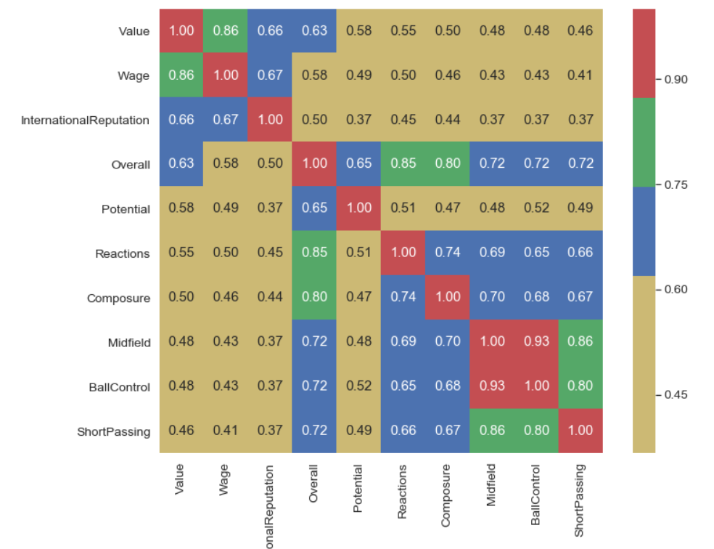
Correlation Matrix – Top 10 with Value

Slide 6
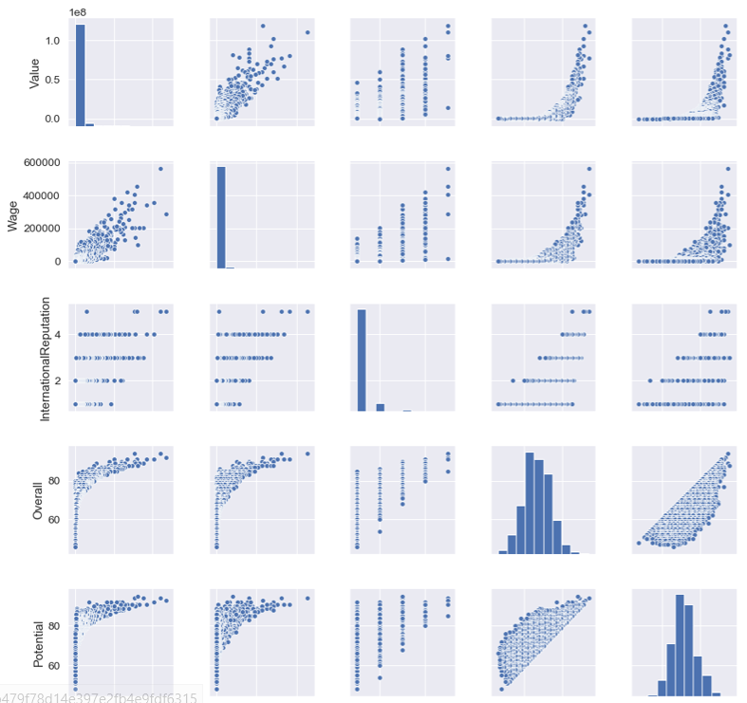
Pairplot

Slide 7
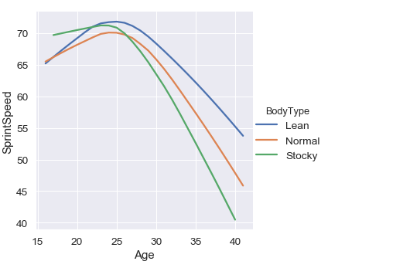
Age vs SprintSpeed

Slide 8
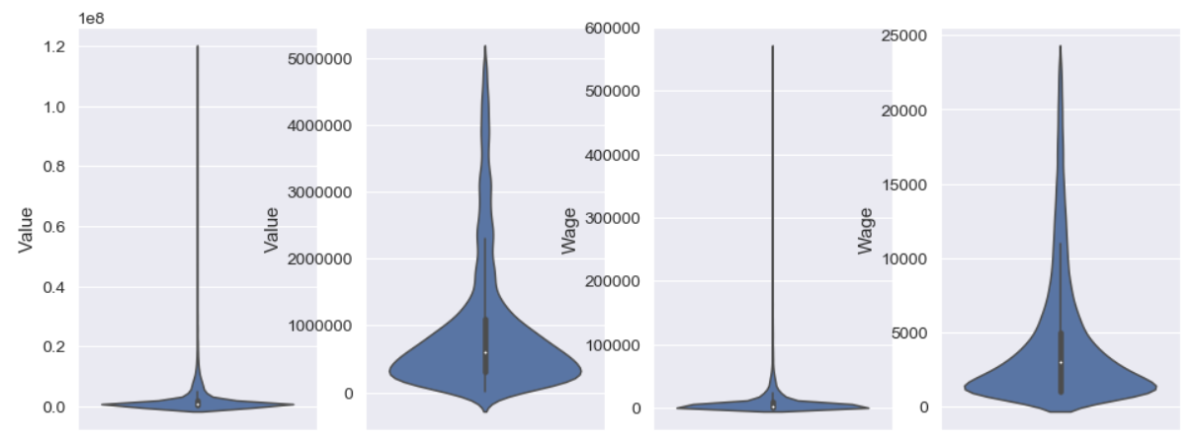
HandlingOutlier’s

Slide 9
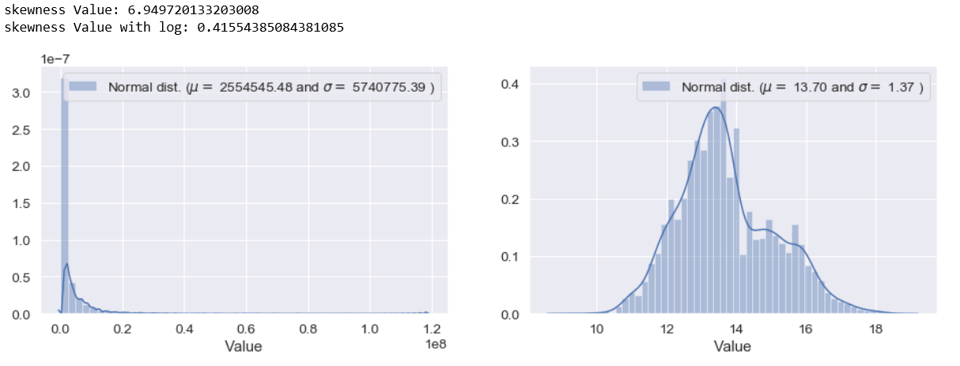
Skewness Handling

Slide 10
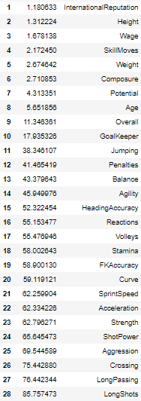
Variation Inflation Factor

Slide 11
Model building – Linear Regression
Iteration1: Before Handling Outliers | 48 features
Adj_R2_Score | 0.8022
RMSE_Train | 2369043
RMSE_Test | 2954591
RMSE_Diff | 585548 (24.71%)
MAE_Test | 1350239
Iteration2: After Treating Outliers | 48 features
Adj_R2_Score | 0.9642
RMSE_Train | 264241
RMSE_Test | 282986
RMSE_Diff | 18745 (7.09%)
MAE_Test | 151695
Iteration3: With Feature Selection | 34 features
Adj_R2_Score | 0.9600
RMSE_Train | 296630
RMSE_Test | 307590
RMSE_Diff | 10960 (3.7%)
MAE_Test | 164249

Slide 12
Model building – Ridge
Iteration4: Ridge Regression | 34 features
Adj_R2_Score | 0.9600
RMSE_Train | 297517
RMSE_Test | 306962
RMSE_Diff | 9445 (3.17%)
MAE_Test | 163485

Slide 13
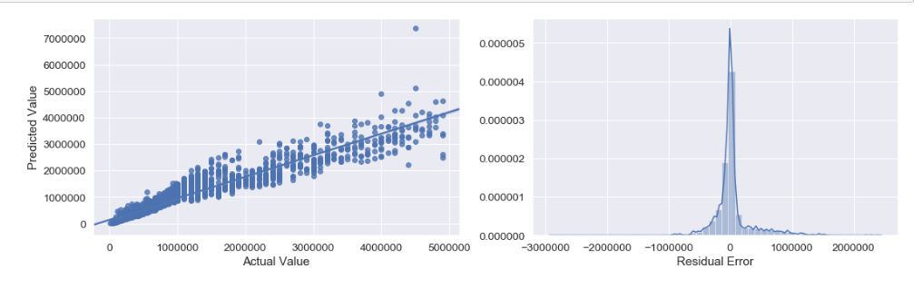
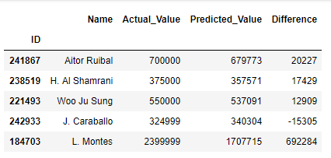
Linear Regression Result

Slide 14
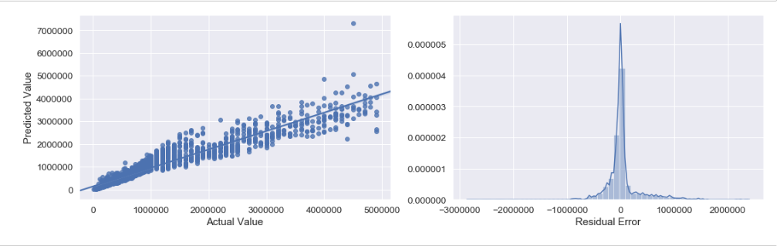
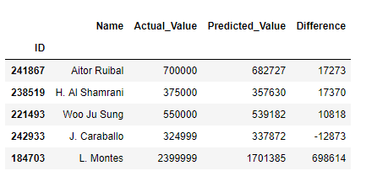
Ridge Regression Result

